Slide 1
Optimizing Blood Pressure Estimation using Multiple Features Extracted from PPG Signals
Optimizing Blood Pressure Estimation using
Multiple Features Extracted from PPG Signals
Final Project Presentation
Students name: Geonwoo Ji and Denis Bernard
Soonchunhyang University

Slide 2
Contents
Optimizing Blood Pressure Estimation using Multiple Features Extracted from PPG Signals
Introduction
Blood pressure and its measurement methods
Problem definition and motivation
Objectives of the project
Proposed methodology
Experiment and Results
Conclusion

Slide 3
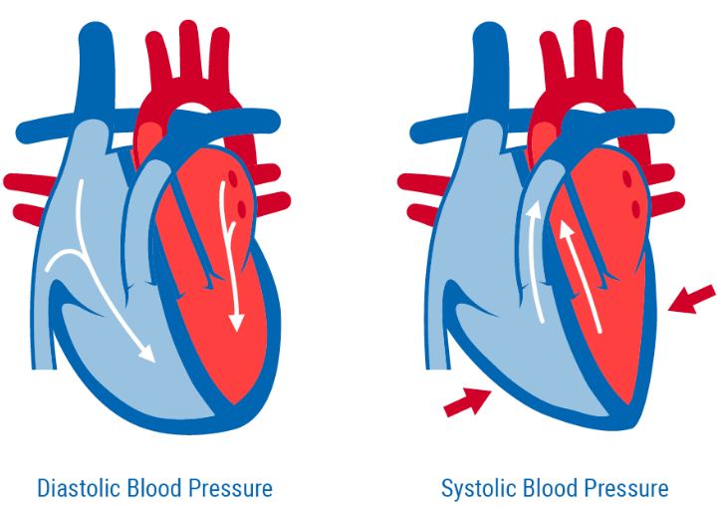
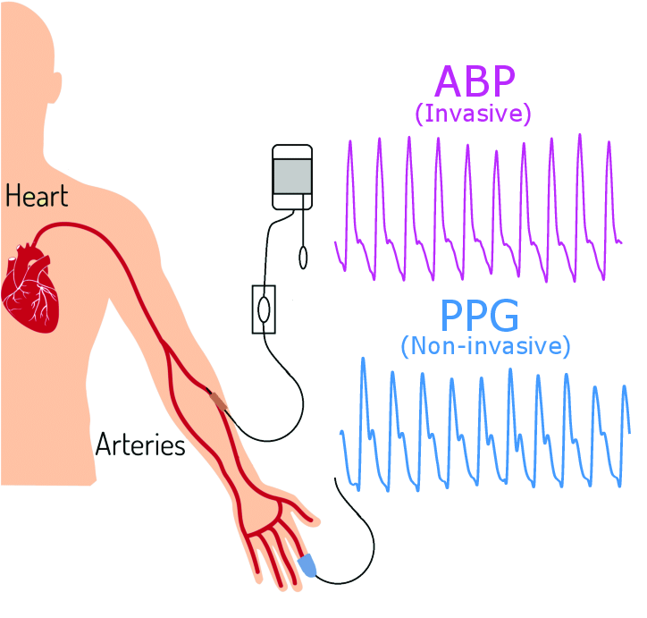
Introduction
Optimizing Blood Pressure Estimation using Multiple Features Extracted from PPG Signals
Blood pressure (BP)
The force exerted by blood as it circulates in the arteries
BP can be described in terms of
Systolic blood pressure (SBP, when the heart beats and BP is at its highest)
Diastolic blood pressure (DBP, when the heart beats and BP is at its lowest)
BP measurement methods
Both invasive and noninvasive methods of BP monitoring
are presently in use
For continuous high accuracy BP measurement,
an invasive arterial line is a clinical standard
However, this approach has negative consequences
as an intrusive measurement, such as a risk of infection
In contrast, for noninvasive BP monitoring,
PPG is a promising method
DBP and SBP
ABP and PPG
https://coredifferences.com/difference between-systolic-and diastolic-blood-pressures/
https://www.mdpi.com/2077-0383/7/10/316

Slide 4
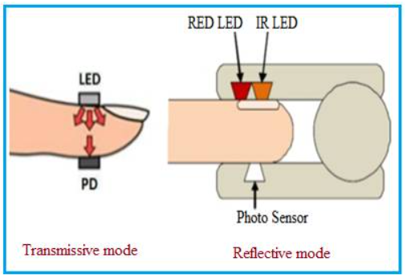
Introduction
PPG provide an optically obtained signal
that can be used to detect changes in the volume of blood in the microvascular tissue bed
In a clinical setting,
this signal is often obtained by a pulse oximeter while patients are ambulatory
Due to its simplicity and low-cost,
PPG has a wide potential for clinical applications, such as the estimation of BP and heart rate
Working principle of PPG sensor
https://www.rfwireless-world.com/Terminology/Advantages-and-Disadvantages-of-PPG-Sensor.html

Slide 5
Problem definition and Motivation
Optimizing Blood Pressure Estimation using Multiple Features Extracted from PPG Signals
Problem statement
Several current state-of-the-art methods extract only a limited number of features from the PPG signal, either in the time or frequency domain, which may be inadequate for effectively training models and achieving optimal results.
Motivation
Our goal is to illustrate the efficacy of utilizing a wide range of PPG features, including statistical, time-domain, frequency-domain, amplitude-based, gradient-based, and morphological features, in machine learning and deep learning models for the purpose of estimating blood pressure.

Slide 6
Objectives of the project
Optimizing Blood Pressure Estimation using Multiple Features Extracted from PPG Signals
The main objective of performing a regression task, such as blood pressure estimation are
To develop a predictive model that can help individuals to get valuable information about their health status.
To develop a predictive model that can help clinicians to identify patients who are at risk for hypertension, hypotension and other cardiovascular diseases, and to better understand the factors that contribute to these conditions.

Slide 7
Proposed methodology
Optimizing Blood Pressure Estimation using Multiple Features Extracted from PPG Signals
The proposed method for estimating BP using the PPG signal have the following steps as shown in the block diagram below.
Where the abbreviation in the block diagram have the following meaning
MIMIC II - Multiparameter Intelligent Monitoring in Intensive Care II
ABP - Arterial Blood Pressure
PPG - Photoplethysmography
SBP - Systolic Blood Pressure
DBP - Diastolic Blood Pressure
MIMI II Database
ABP & PPG Acquisition
Preprocessing
Segmentation
Estimate
DBP
Machine Learning or Deep Learning
Feature Extraction
SBP

Slide 8
MIMIC II Dataset
Optimizing Blood Pressure Estimation using Multiple Features Extracted from PPG Signals
MIMIC II (Multiparameter Intelligent Monitoring in Intensive Care II)
From University of California Irvine (UCI) Machine Learning Repository
Widely used for a comparative analysis with other related work
The dataset contained
Electrocardiogram (ECG) signals
Photoplethysmography (PPG) signals
and arterial blood pressure (ABP) signals from 12,000 patients
These parameters were simultaneously measured at a sampling rate of 125 Hz
PPG and ABP signals were collected through fingertip and invasive measurements respectively
ABP signals can indicate considerable information regarding cardiovascular functions
therefore, in this study, SBP and DBP were calculated based on ABP signals
https://archive.ics.uci.edu/ml/datasets/Cuff-Less+Blood+Pressure+Estimation

Slide 9
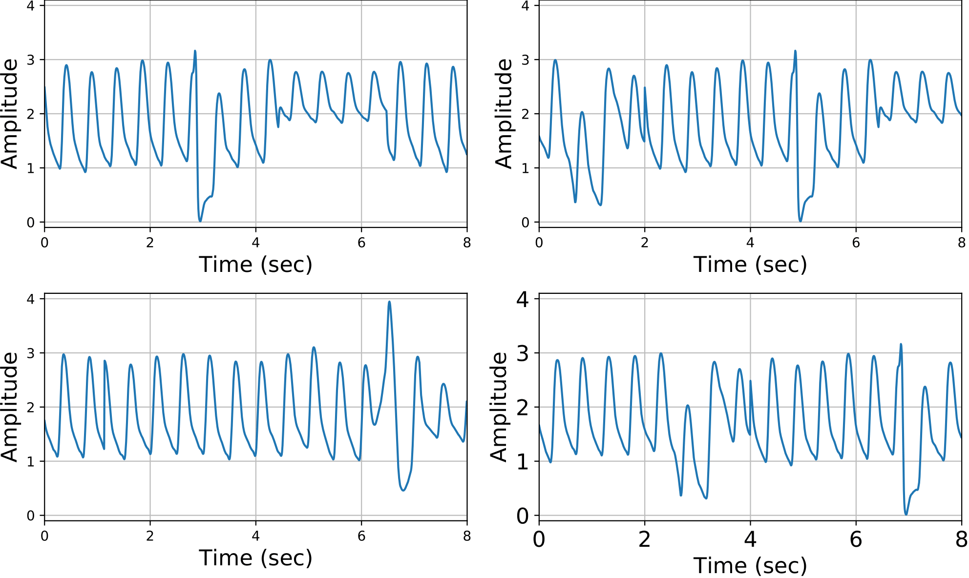
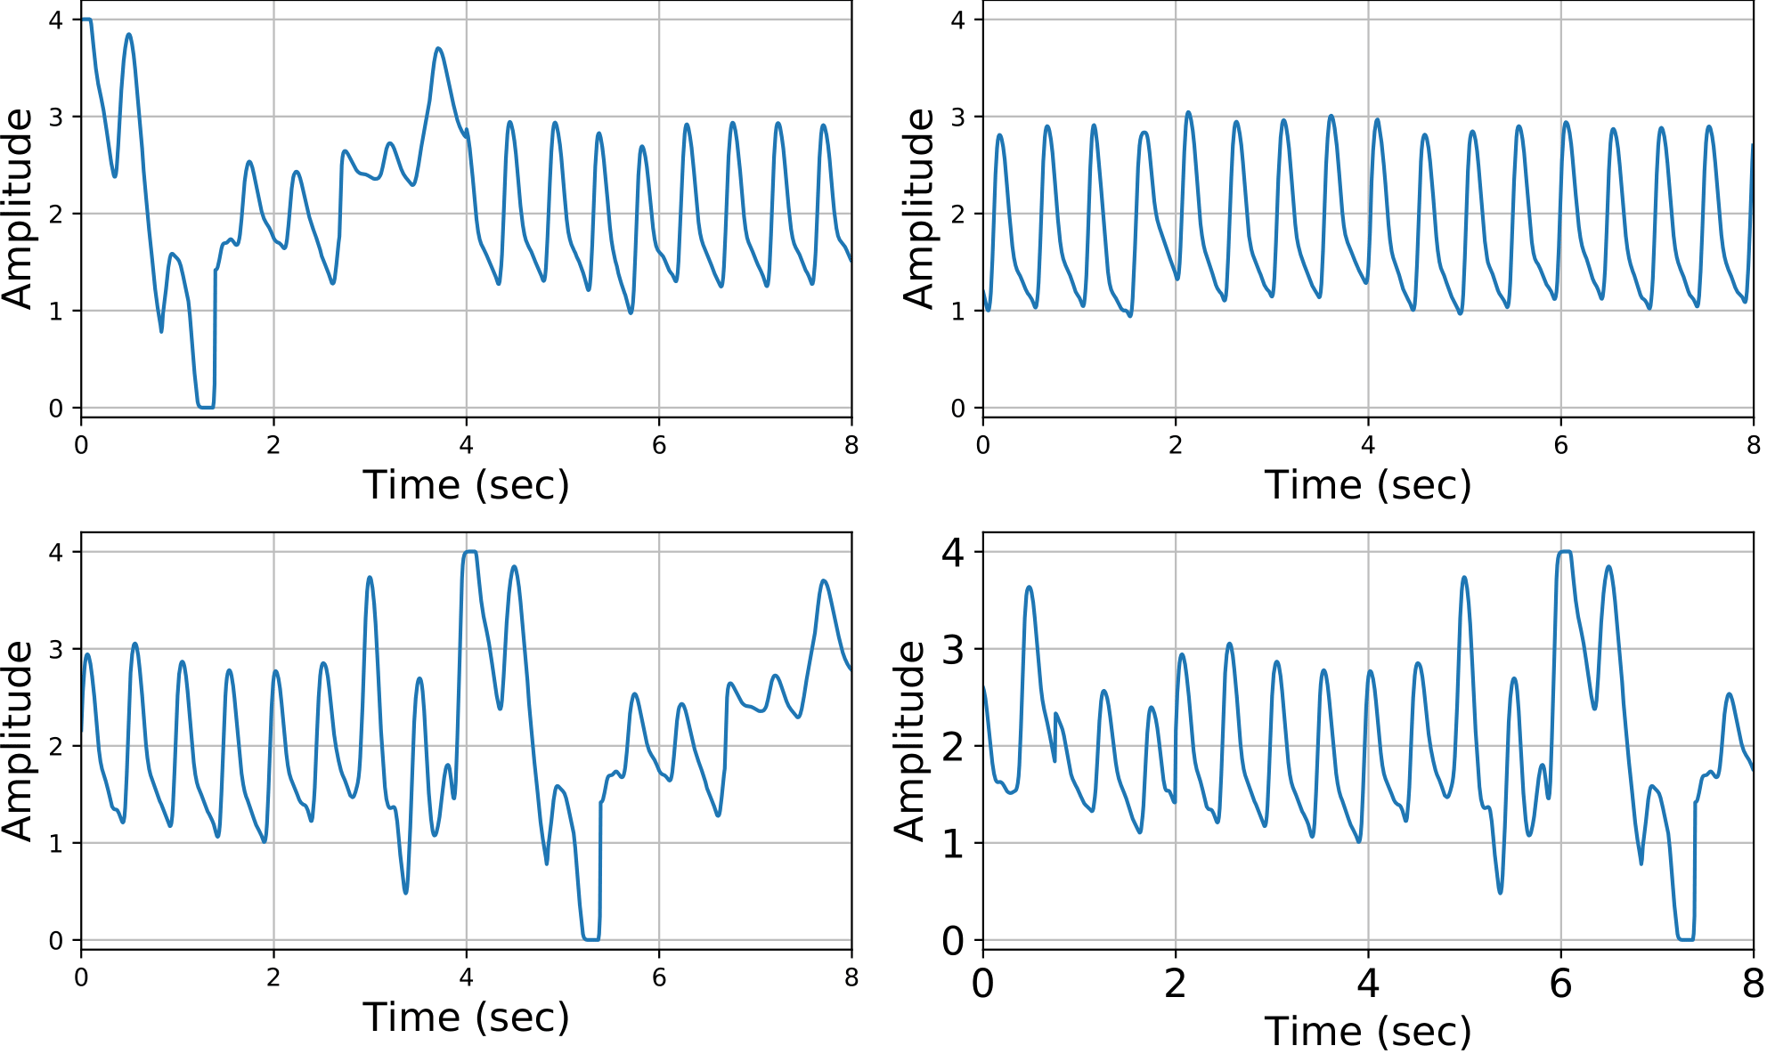
Preprocessing and segmentation of PPG signal
Optimizing Blood Pressure Estimation using Multiple Features Extracted from PPG Signals
Preprocessing of ABP signal
Criteria to obtain the DBP and SBP values
60 ≤ DBP ≤ 130 (exclude DBP values less than 60 and DBP values greater than 130)
80 ≤ SBP ≤ 180 (exclude SBP values less than 80 and SBP values greater than 180)
Segmentation of PPG signal
We used sliding window to extract 8 second overlapped window (with 2 second stride)
8 second window of inappropriate PPG signal that were applied in this work
8 second window of inappropriate PPG signal because of drug influence, sensor
movement, and other circumstances

Slide 10
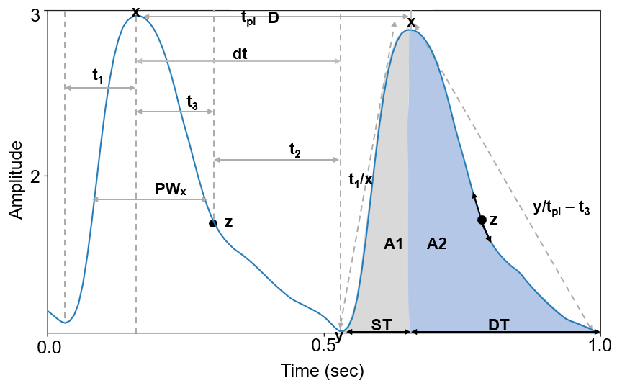
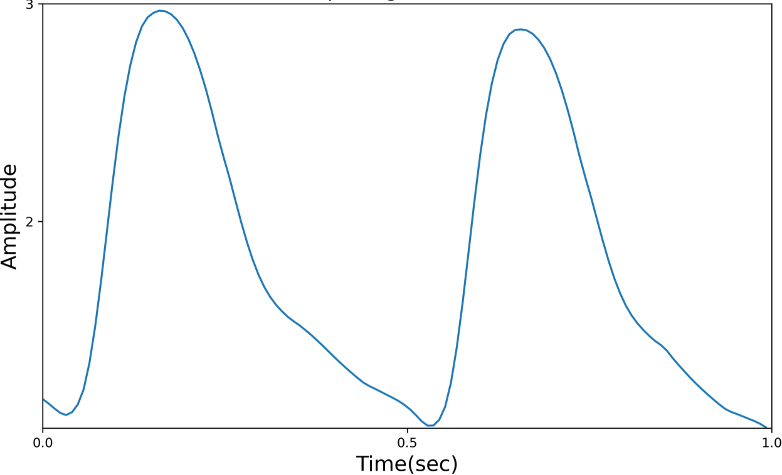
Feature extraction
Optimizing Blood Pressure Estimation using Multiple Features Extracted from PPG Signals
Feature extraction from PPG signal
Target values extraction from ABP signal
PPG signal and expected features to be extracted
Feature Extraction
From the PPG signal 82 features were extracted such as:-
Statistical features,
Time-domain features,
Frequency domain features,
Amplitude-based features,
Gradient-based features, and
Morphological features
From the ABP signal, SBP and DBP values will be extracted
SBP
Feature Extraction
Extracting SBP and DBP values from each ABP signal
DBP

Slide 11
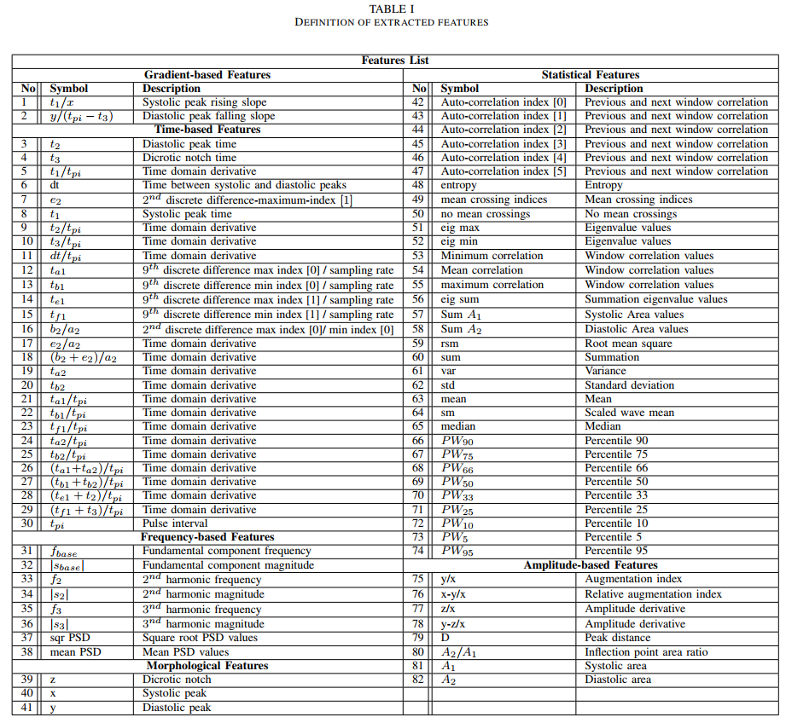
List of 82 features extracted from PPG signal
Optimizing Blood Pressure Estimation using Multiple Features Extracted from PPG Signals

Slide 12
Experiment and Results
Optimizing Blood Pressure Estimation using Multiple Features Extracted from PPG Signals
Experiment setting
Programming language : Python
Python libraries : TensorFlow and Keras
Device: Nvidia Jetson AGX Xavier
We performed 10-fold cross validation for each experiment
GPU: 512-core Volta GPU with tensor cores
CPU: 8-core ARM v8.2 64-bit CPU, 8MB L2 + 4MB L3
Memory: 32GB 256-Bit LPDDR4x or 137GB/s
Storage of 32GB eMMC 5.1

Slide 13
Machine Learning and CNN variant Results
Machine Learning results
CNN variant results
ML Models
DBP (mmHg) | SBP (mmHg)
MAE ± STD | RMSE | MAE ± STD | RMSE
Extra Tree | 3.83 ± 5.70 | 5.73 | 8.81 ± 12.73 | 12.74
LightGBM | 3.84 ± 5.72 | 5.71 | 8.98 ± 12.75 | 12.76
Lasso | 6.82 ± 8.66 | 6.26 | 8.72 ± 12.72 | 12.85
Ridge | 6.48 ± 8.36 | 8.40 | 16.00 ± 19.49 | 19.53
CNN Variants
DBP (mmHg) | SBP (mmHg)
MAE ± STD | RMSE | MAE ± STD | RMSE
AlexNet | 2.62 ± 11.89 | 11.90 | 4.84 ± 24.94 | 25.00
LVGG16 | 4.28 ± 6.21 | 6.26 | 8.72 ± 12.72 | 12.85
GoogLeNet | 3.09 ± 4.61 | 4.63 | 4.72 ± 7.52 | 7.54

Slide 14
Design of the proposed ResNet-50 Model
Optimizing Blood Pressure Estimation using Multiple Features Extracted from PPG Signals
The model consists of 5 stages each with a convolution and Identity block. Each convolution block has 3 convolution layers and each identity block also has 3 convolution layers
Output
SBP
Input
Flattening
Avg Pool
Conv Block
FC
Zero padding
ID Block
ID Block
ReLU
Conv Block
Batch Norm
Conv
Max Pool
Conv Block
Conv Block
ID Block
ID Block
DBP
Stage 1
Stage 2
Stage 3
Stage 4
Stage 5

Slide 15
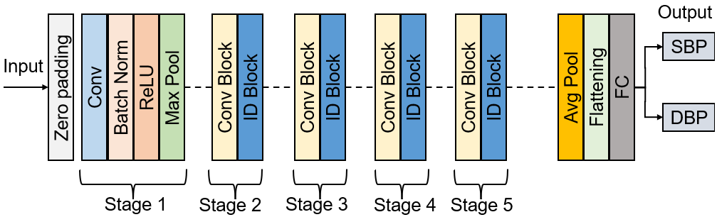
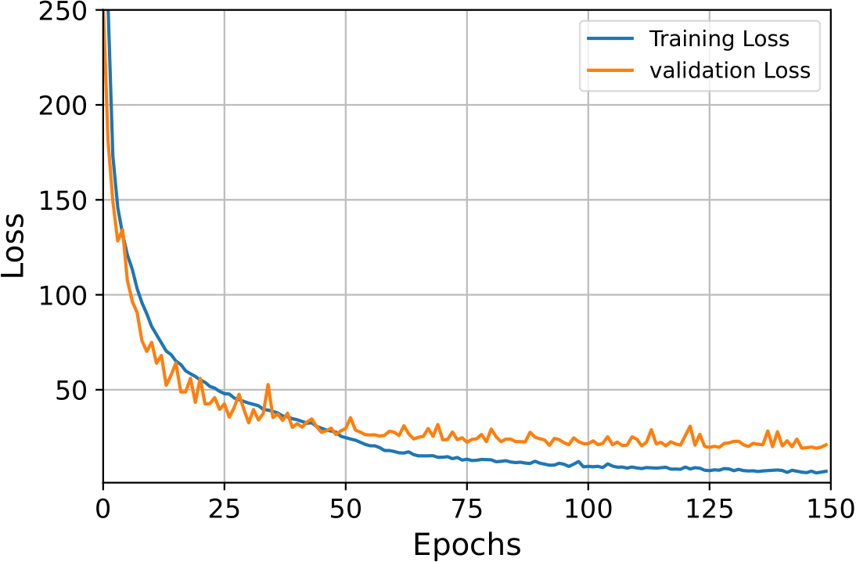
ResNet-50 Model Training
Optimizing Blood Pressure Estimation using Multiple Features Extracted from PPG Signals
Training the ResNet-50 model
Learning curve After training the ResNet-50 model

Slide 16
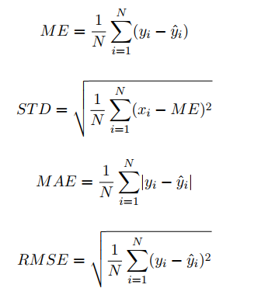
BP Estimation with ResNet-50 Model Results
Optimizing Blood Pressure Estimation using Multiple Features Extracted from PPG Signals
Objective functions
Results of our proposed ResNet-50 model
Proposed Model
DBP (mmHg) | SBP (mmHg)
MAE ± STD | RMSE | MAE ± STD | RMSE
ResNet-50 | 2.03 ± 3.12 | 3.15 | 3.61 ± 5.66 | 5.70

Slide 17
BP Estimation with ResNet-50 Model Results
Optimizing Blood Pressure Estimation using Multiple Features Extracted from PPG Signals
Performance comparison with previous work
Authors | Model
DBP (mmHg) | SBP (mmHg)
MAE ± STD | MAE ± STD
3.36 ± 4.48 | 5.59 ± 7.25
3.15 ± 2.47 | 4.95 ± 4.15
2.27 ± 1.82 | 4.02 ± 2.79
2.30 ± 0.19 | 3.97 ± 0.06
4.17 ± 4.22 | 8.22 ± 10.38
2.03 ± 3.12 | 3.15 ± 5.66
Rong et al. [8] | MTFF-ANN (2CNN+1 LSTM
Wang et al. [9] | LASSO-LSTM
Wang et al. [12] | ANN
Panwar et al. [16] | LRCN
Hasanzadeh et al. [23] | AdaBoost
This work | ResNet-50

Slide 18
Comparison with British Hypertension Society (BHS)
Optimizing Blood Pressure Estimation using Multiple Features Extracted from PPG Signals
The British Hypertension Society (BHS) standard
The BHS grades BP measurement devices based on their cumulative percentage of error under their different thresholds, which are 5, 10, and 15 mmHg
This standard includes grades A, B and C
Our model conforms to the BHS international standards
Cumulative Percentage Error
≤ 5 mmHg | ≤ 10 mmHg | ≤ 15 mmHg
BHS [33]
Grade A | 60% | 85% | 95%
Grade B | 50% | 75% | 90%
Grade C | 40% | 65% | 85%
DBP | 85.5% | 90.5% | 92.8%
SBP | 82.4% | 89.3% | 91.6%
Our Results

Slide 19
Comparison with Advancement of Medical Instrumentation (AAMI)
Optimizing Blood Pressure Estimation using Multiple Features Extracted from PPG Signals
The Association for the Advancement of Medical Instrumentation (AAMI)
AAMI recommends that the mean error (ME) of blood pressure measurement from both methods should not exceed 5 mmHg, and the standard deviation should not be greater than 8 mmHg
Our model conforms to the AAMI international standards
 | ME (mmHg) | STD (mmHg) | Subjects
DBP & SBP | ≤ 5 | ≤ 8 | ≥ 85
DBP | 0.91 | 1.68 | 912
SBP | 1.15 | 2.43 | 912
AAMI [32]
Our Results

Slide 20
Conclusion
Optimizing Blood Pressure Estimation using Multiple Features Extracted from PPG Signals
We propose a ResNet-50 architecture consisting of 5 stages each with a convolution and Identity block. Each convolution block has 3 convolution layers and each identity block also has 3 convolution layers which operate directly on the PPG features to reduce information loss and effectively model the PPG-BP relationship.
The goal of this work is to demonstrate how to use PPG signals to make continuous blood pressure monitoring easier for older or fragile individuals. To be more specific, we concentrate at feature extraction strategies in order to improve the accuracy of blood pressure estimation.
We investigate the performance of machine learning algorithms, including traditional machine learning (Lasso, Ridge, ExtratreeRegressor, LGBM), and deep learning (i.e., VGG16, GoogleNet, AlexNet and ResNet-50)

Slide 21
References
J. Allen, “Photoplethysmography and its application in clinical physiological measurement,” Physiological measurement, vol. 28, no. 3, p. R1, 2007.
S. Maqsood, S. Xu, M. Springer, and R. Mohawesh “A Benchmark Study of Machine Learning for Analysis of Signal Feature Extraction Techniques for Blood Pressure Estimation Using Photoplethysmography (PPG),” IEEE Access, vol. 9, pp. 138817-138833, 2021.
M. Rong and K. Li, “A multi-type features fusion neural network for blood pressure prediction based on photoplethysmography,” Biomedical Signal Processing and Control, vol. 68, pp. 102772, 2021.
D. Wang, X. Yang, X. Liu, L. Ma, L. Li, and W. Wang, “Photoplethysmography-based blood pressure estimation combining filter-wrapper collaborated feature selection with lasso-lstm model,” IEEE Transactions on Instrumentation and Measurement, vol. 70, pp. 1-14, 2021.
S. G. Khalid, H. Liu, T. Zia, J. Zhang, F. Chen, and D. Zheng, “Cuffless blood pressure estimation using single channel photoplethysmography: a two-step method,” EEE Access, vol. 8, pp. 58146-58154, 2020.

Slide 22
Q&A
Thank you
Questions?
Contact:

